Slide 1
MS Azure – Day 3

Slide 2
Azure storage services
Notes:
Day - 3
Duration -120 Mins
Mode of delivery : Instructor Lead

Slide 3
What you will learn
At the core of the lesson
You will learn:
Introduction to Azure Storage Services
Types of storage account options and storage types
Azure access tiers
Azure Storage Redundancy

Slide 4

Azure Storage Services
“Azure Storage is a cloud storage solution for modern data storage scenarios”
A storage account provides a unique namespace for your Azure Storage data that's accessible from anywhere in the world over Internet.
Data in this account is secure, highly available, durable, and massively scalable.

Slide 5
Azure Storage features and benefits
These features apply to all Azure Storage offerings:
Durability
High Availability
Scalability
Security
Accessibility
Notes:
Chapter3 – Azure storage services
Durability - Azure Storage data is replicated multiple times across regions.
High Availability - With such durable features, storage services will automatically be highly available.
Scalability - Data is automatically scaled out and load-balanced to meet peak demands.
Security - Azure Storage relies on a Shared Key model for authentication security.
Accessibility - Azure Storage data are accessible from anywhere in the world over HTTP or HTTPS.

Slide 6
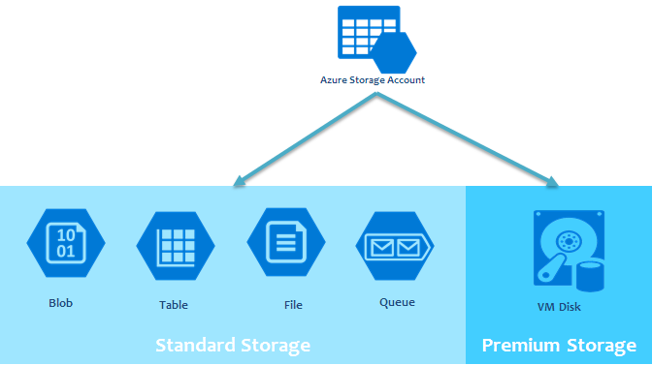
Different types of storage services:
Azure Blob Storage (Azure Blobs)
Azure File Storage (Azure Files)
Azure Queue Storage (Azure Queues)
Azure Table Storage (Azure Tables)
Azure Disk Storage (Azure Disks)
Notes:
Chapter3-Azure Storage Services
Azure Blob Storage is basically a storage for unstructured data that can include pictures, videos, music files, documents, raw data, and log data…along with their meta-data.
Azure Files are organized file shares for cloud deployments.
Azure Queue is a messaging store for consistent messaging between components.
Azure Tables are NoSQL store for schema-less storage od structured data.
Azure Disk allows data to be persistently stored and accessed from an attached virtual hard disk.

Slide 7

Azure Blob (Binary long object) Storage
It is Microsoft's object storage solution for the cloud. Blob storage is optimized for storing a massive amount of unstructured data, such as text or binary data.
Notes:
Chapter3-Azure Storage Services
URL format is https://<storage-account-name>.blob.core.windows.net

Slide 8
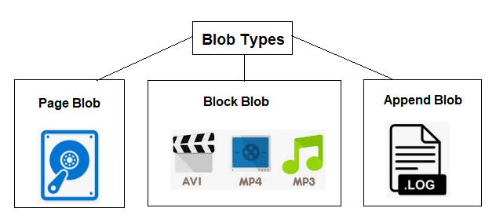
Azure offers three types of blob service:
Block blob
Append blob
Page blob
Notes:
Chapter3-Azure Storage Services
Block blob: It stores text binary data up-to about 4.7 TB. It is the block of data that can be managed individually.
Append blob: It is made up of blocks like block blobs but are optimized for append operations. It is ideal for an application like logging data from virtual machines.
Page blob: It stores random access files up-to 8 TB. Page blobs store the VHD files that backs VMs.

Slide 9
Azure Storage Account Overview
An Azure Storage Account can be considered as a container that combines a set of Azure Storage services together.
Types of Storage Accounts:
Standard general-purpose v2
Premium block blobs
Premium file shares
Premium page blobs
Notes:
Chapter3 – Azure storage services
Standard general-purpose v2 Standard storage account type for blobs, file shares, queues, and tables. Recommended for most scenarios using Azure Storage.
Premium block blobs Premium storage account type for block blobs and append blobs. Recommended for scenarios with high transaction rates or that use smaller objects or require consistently low storage latency.
Premium file shares Premium storage account type for file shares only. Recommended for enterprise or high-performance scale applications.
Premium page blobs Premium storage account type for page blobs only.

Slide 10
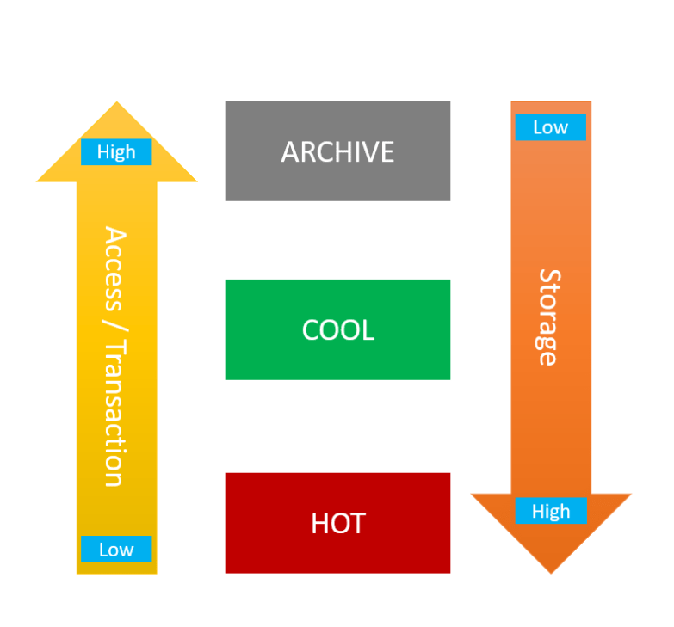
Azure Storage Access Tiers includes:
Hot
Cold
Archive
Notes:
Chapter3 – Azure storage services
Hot tier - An online tier optimized for storing data that is accessed or modified frequently. The hot tier has the highest storage costs, but the lowest access costs.
Cold tier - An online tier optimized for storing data that is infrequently accessed or modified. Data in the cool tier should be stored for a minimum of 30 days. The cool tier has lower storage costs and higher access costs compared to the hot tier.
Archive tier - An offline tier optimized for storing data that is rarely accessed, and that has flexible latency requirements, on the order of hours. Data in the archive tier should be stored for a minimum of 180 days.

Slide 11
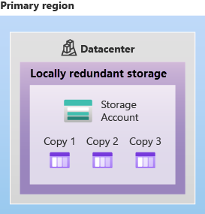
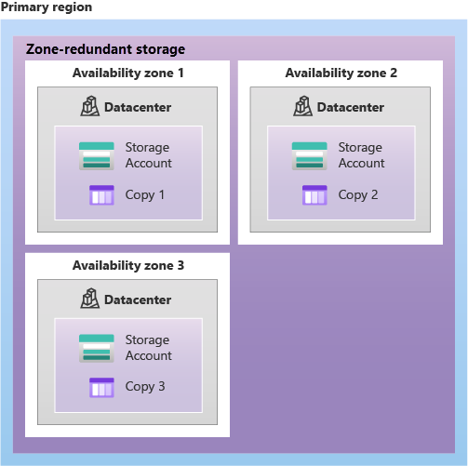
Azure storage redundancy
Azure Storage always stores multiple copies of your data so that it's protected from transient hardware failures, network or power outages, and natural disasters.
Redundancy in the primary region offers two options
Locally redundant storage (LRS)
Zone-redundant storage (ZRS)
Notes:
Chapter3 – Azure storage services
Locally redundant storage (LRS) replicates your data three times within a single data center in the primary region. LRS provides at least 11 nines of durability (99.999999999%) of objects over a given year.
Zone-redundant storage (ZRS) replicates your Azure Storage data synchronously across three Azure availability zones in the primary region. ZRS offers durability for Azure Storage data objects of at least 12 nines (99.9999999999%) over a given year.

Slide 12
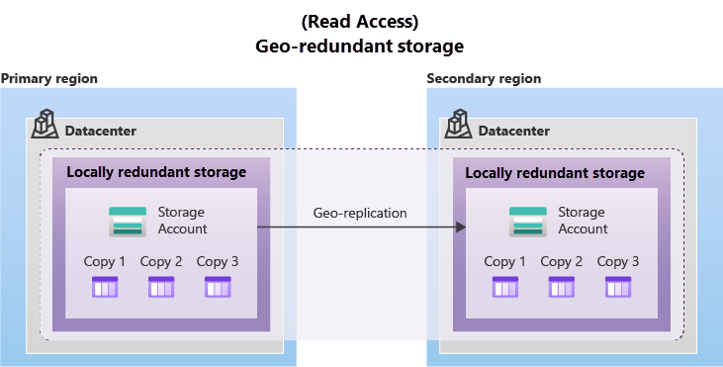
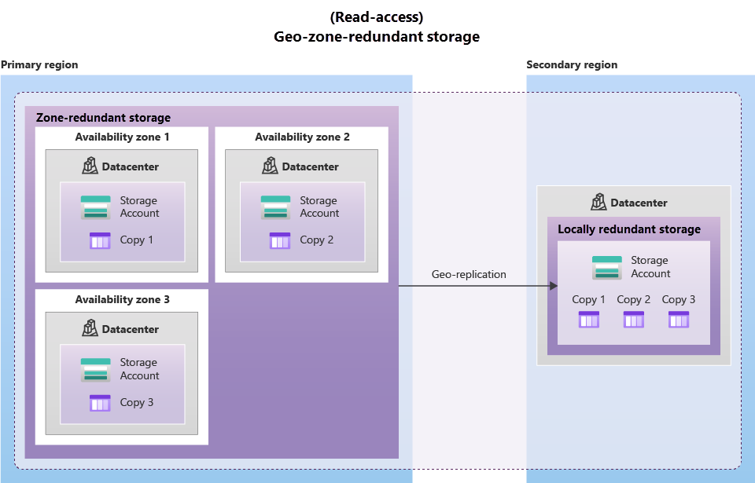
Redundancy in a secondary region offers two options:
Geo-redundant storage (GRS)
Geo-zone-redundant storage (GZRS).
Notes:
Chapter3 – Azure storage services
Geo-redundant storage (GRS) data is synchronously replicated for three times within a single physical location in the primary region using LRS, then asynchronously replicated to a single physical location in the secondary paired region(3 more copies) using LRS.
GRS offers durability for Azure Storage data objects of at least 16 nines (99.99999999999999%) over a given year.
Geo-zone-redundant storage (GZRS) data is synchronously replicated 3 times across 3 availability zones in the primary region, then asynchronously replicated to the secondary paired region (3 more copies).
GZRS is designed to provide at least 16 nines (99.99999999999999%) of durability of objects over a given year.

Slide 13
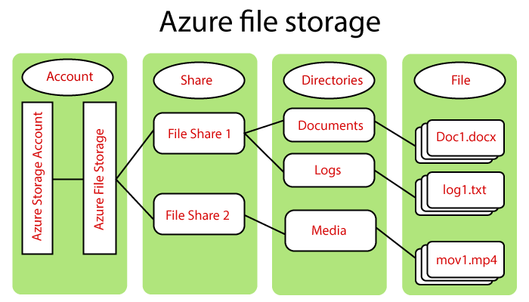
Azure File Storage (Azure Files)
Azure file storage mainly can be used if we want to have a shared drive between two servers or across users. In that case, we will go for Azure file storage.
Notes:
Chapter3 – Azure storage services
Concepts related to Azure file storage:
URL Format is https://<storage-account-name>.file.core.windows.net
Storage Account: All access to Azure Storage service is done through a storage account.
Share: A file storage Share is an SMB file share in Azure.
Directory: It is an optional hierarchy of directories.
File: A file in the share. A file may be up to 1 TB in size.

Slide 14
Azure Files key benefits:
Shared access
Fully managed
Resiliency
Scripting and tooling
Familiar programmability
Notes:
Chapter3 – Azure storage services
Shared access: Azure file shares support the industry standard SMB and NFS protocols, meaning you can seamlessly replace your on-premises file shares with Azure file shares without worrying about application compatibility.
Fully managed: Azure file shares can be created without the need to manage hardware or an OS.
Scripting and tooling: PowerShell cmdlets and Azure CLI can be used to create, mount, and manage Azure file shares as part of the administration of Azure applications.
Resiliency: Azure Files has been built from the ground up to always be available.
Familiar programmability: Applications running in Azure can access data in the share via file system I/O APIs. Developers can therefore leverage their existing code and skills to migrate existing applications.

Slide 15
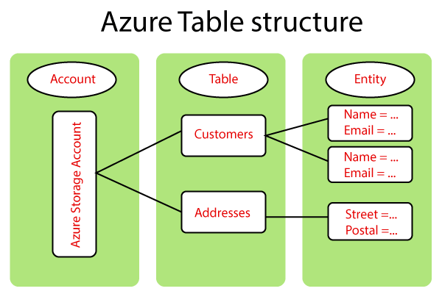
Azure Table storage
Azure Table storage is used for storing a large amount of structured data.
This service is a NoSQL data storage, which accepts authenticated calls from inside and outside of the Azure cloud.
Notes:
Chapter3 – Azure storage services
URL format is https://<storage-account-name>.table.core.windows.net
Accounts: Every access to Azure storage service is done through a storage account, and all access to Azure Cosmos DB is done through a Table API account.
Table: It is a collection of entities. As we know, tables don't put a schema on entities that mean a single table can contain entities with different properties set.
Entity: It is a set of properties, a similarly as database row. Azure Storage can be of 1MB in the size of the entity.
Properties: It is a name-value pair where each entity can include up to 252 properties to store the data, and in addition to user properties, that means whatever the features you add.

Slide 16
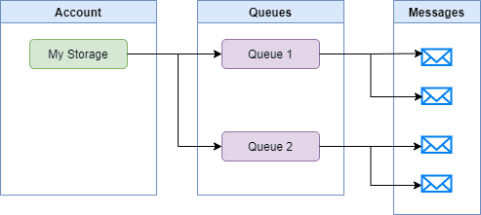
Azure Queue Storage
It is a service for storing large number of messages in the cloud.
A queue contains a set of message, Queue name must be all lowercase.
Notes:
Chapter3 – Azure storage services
A single queue message can be up to 64KB in size. A message can remain in the queue for a maximum time of 7 days
URL format is https://<storage-account-name>.queue.core.windows.net
When the message is retrieved from the queue, it stays invisible for 30 seconds. A message needs to be explicitly deleted from the queue to avoid getting picked up by another application.

Slide 17
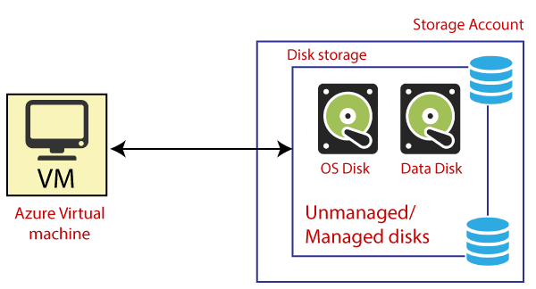
Azure Disk Storage
Disk storage, or Azure managed disks, are block-level storage volumes managed by Azure for use with Azure VMs.

Slide 18
THANK YOU

